Slide 1
Dream... and let dream
Message from the Pope Francis by the 28th GC
Don Casti

Slide 2

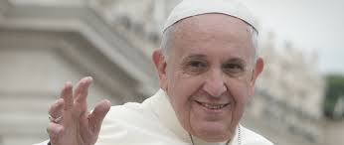
Message from the Pope Francis by the 28th GC
The gift from a friend to all the Salesian Family :
to come back on the footprint of Don Bosco

Slide 3

To realize a true « Option Valdocco » gift and challenge
Not only the contemplation
of a former story,
but the strength facing the present
of the life in the world,
in the Church,
of in the Congregation
and in the Association

Slide 4
The questions
How to give today a concrete expression
for this style of salesian action ?
How to surch the good inspirations in order to live fully the challenges of today and to prepare the future of the charisma ?

Slide 5
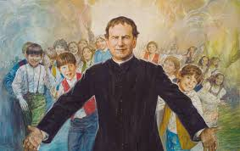
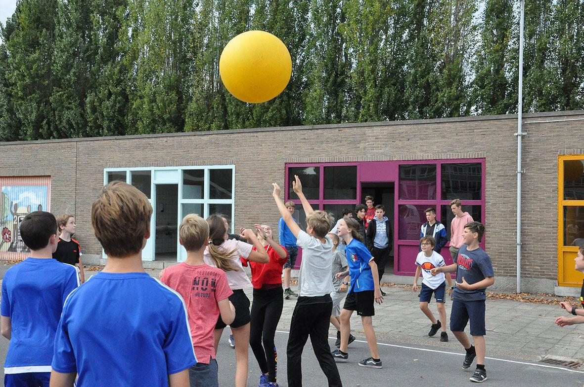
Our time is nor better nor worse but different from this when Don Bosco was alive

Slide 6
5 points of our salesian identity to be considered in an inventive loyalty
1. To revive the gift we have received
2. The option « Valdocco » and the gift for the youth
3. The option « Valdocco » and the charisma of the presence
4. The option « Valdocco » in the multiplicity of the langages
5. The option « Valdocco » and the ability of dreaming

Slide 7

1. The discernment, the root of the revival
To let come the gift alive again:
every charisma is a lively fire we have to rouse continuously in order that it could light and warm up again

Slide 8
1. The discernment, the root of the revival
No repetitive faithfulness,
but a creative faithfulness

Slide 9
Thought
In which way,
as individual Salesians cooperators, as Centres, do we organize genuine processes of discernment, able to generate alternative processes in order to avoid a vicious circle as « it has always been so » ?

Slide 10
2. The spirit to immerse into the reality and the education of the trust
  The courage to reach the reality : Don bosco was plunged in the reality
The logic of the Incarnation, forewarning of the heavenly education,
total sharing of the life of the Mankind
The falling-down of all « security distance » and of all
« separating wall » - to get in a risky aera,
source of tension and fear

Slide 11
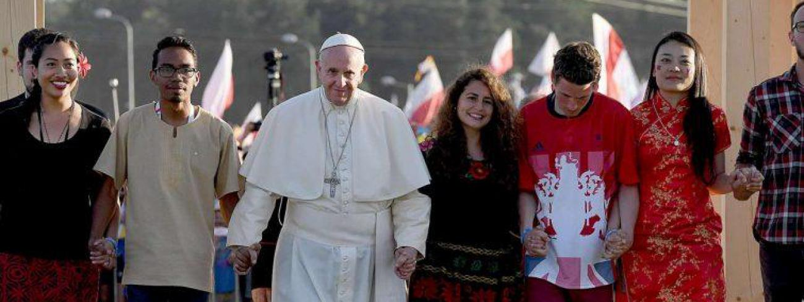
2. The spirit to immerse into the reality and the education of the trust
The certainty that the young people are the children of God !

Slide 12
2. The spirit to immerse into the reality and the education of the trust
• To share the talents
• To share the co-responsability
• To create a surrounding in whiche everybody feels to be
the subject of the mission
• To generate a Church where every kind of clericalism is banished :
the salesian will attend to generate this dynamism with humbleness

Slide 13
Thought
Which risks are we taking today for the good of the youngs ?
Are we really then giving them trust,
on the local, provincial, regional, world level ?
Do we have the courage to make them part
of our educational mission ?

Slide 14
3. The mission, core of the calling and soul of the education
Which Salesian Cooperator for the world of today ?
This question introduce us in the main theme
of the relation between calling, education and mission.
The Plan of the Apostolical Life expresses it clearly,
but we must to live it.

Slide 15
3. The mission, core of the calling and soul of the education
The link between mission and calling
• The calling :
an appeal to get out of oneself for meeting the others
• The mission :
the baptism as foundation, the being ranking before the possession
• The Association :
when it is getting out in order to meet young people and so taking over its missonary identity and not when shutting oneself away for trying to survive

Slide 16
3. The mission, core of the calling and soul of the education
• The mission is the heart of the education
the initial and continuous education may not become a prior proceeding, parallely or separately from the identity and the sensitivity of the follower. When we isolate ourself or when we get away
from the people we are requested to serve, our identity begins to be distorted and becomes a caricature.
• 2 obstacles to overcome : clericalism and rigorism

Slide 17
3. The mission, core of the calling and soul of the education
• The Pope says :
I encourage you to carry on your efforts to make of your houses an « ecclesial laboratory » able to recognize, to appreciate, to stimulate and to encourage the different calls and missions from the Church, because « the evangelization implicates every baptized in the full participation
and full citizenship »

Slide 18
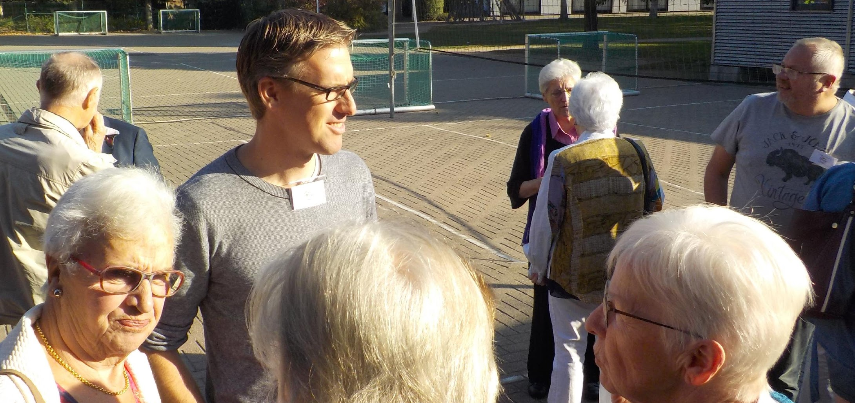
3. The mission, core of the calling and soul of the education
• The local Centres, a fundament subject of the mission :
to be a joyful and desinterested among the youngs

Slide 19
Thought
• Is the local Centre the subject of the mission of today ?
• How is the Centre in which we operate a « permanent laboratory »
for education, spirituality and mission ?

Slide 20
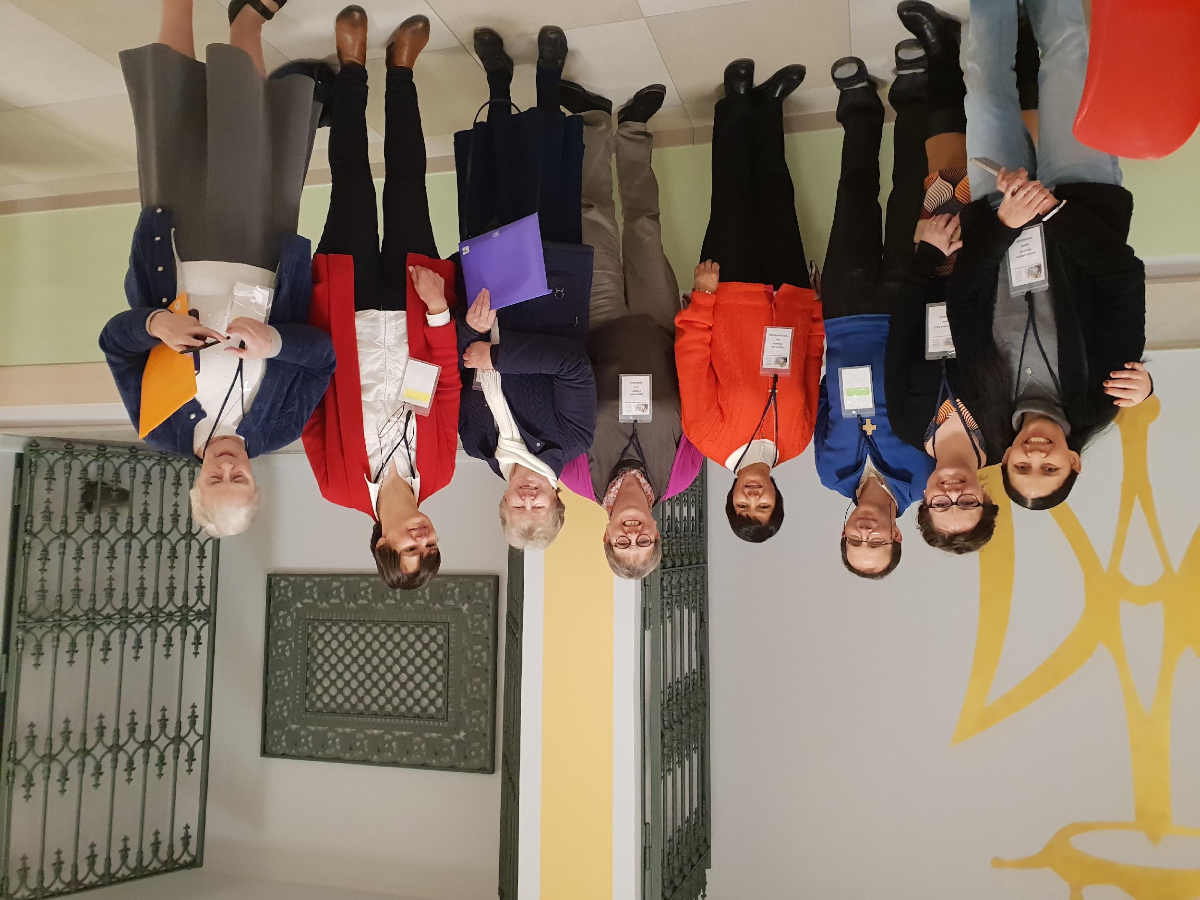
4. Acquisition of the culture and interculturality of the salesian charisma
The universality : the option « Valdocco » in the multiplicity of languages

Slide 21
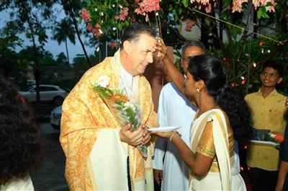
4. Acquisition of the culture and interculturality of the salesian charisma
• Acquisition of the culture : the ability to identify the seeds of the Spirit present in every human culture, where the grace comes always before the presence of the Church and the announcement of the salvation

Slide 22
4. Acquisition of the culture and interculturality of the salesian charisma
• Interculturality : the specific richness coming out the meeting between different cultures able to enrich one another in a real exchange of gifts, creating so new relational dynamics
The Christianity has no unique cultural model to which all the other cultures ought to conform, denying their specificity

Slide 23
Thought
• How to take in account the fact that the salesian charisma lives with a continuous exchange of gifts ?
• How do we live the nowadays changing of the Association in its local, provincial, regional and world dimension ?

Slide 24
5. To be inspired by the grace of the beginning
• A creative ability
The Church and the Association will only give a birth to a revival when they are able to have an effect on the heart of the youngs
in their imagination, when they succeed in arousing big ideals worth for all the life, when they present the faith as a venture able to rally the life with a positive and fascinating meaning

Slide 25
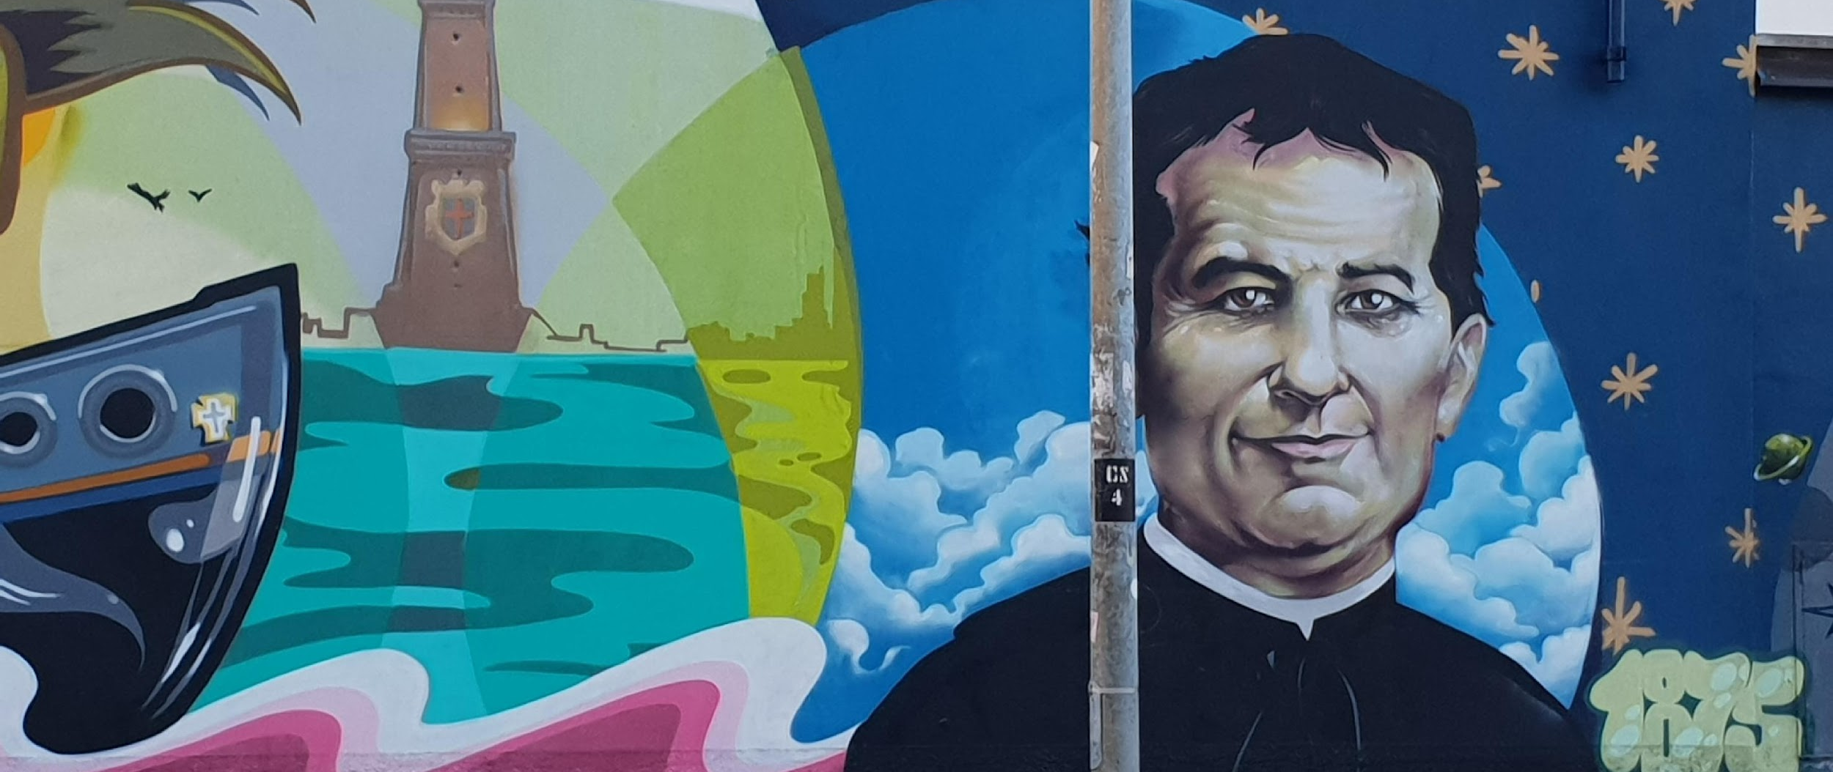
Thought
• How do we feed our creative ability ?
• Which are our big dreams ?

